Slide 1

Fatal Police Shootings in the United States from 2015-2022 Team 7 Midterm Exploratory Data Analysis Alex Khater, Rajeev Koneru, Cora Martin

Slide 2

Data Set Information
In response to a severe lack of reporting within government sources, The Washington Post compiled a database of every fatal police shooting in the United States from 2015-2022. We are interested in exploring this data, specifically as it relates to differences between U.S. states and regions.
After accounting for null values, the data set we are working with has 6,574 observations. Below we have provided a sample row of the data:
Name | Date | Manner of Death | Armed | Age | Gender
Tim Elliot | 10/04/2022 | Shot | Gun | 53 | M
Race | City | State | Signs of Mental Illness | Threat Level | Flee
A | Shelton | WA | 1 | Attack | Not fleeing
Body Camera | Longitude | Latitude | Is Geocoding Exact
FALSE | -123 | 47.2 | TRUE

Slide 3
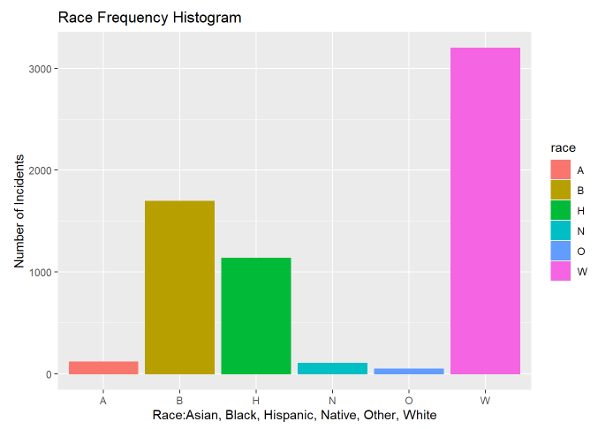
Univariate Analysis #1: Race

Slide 4
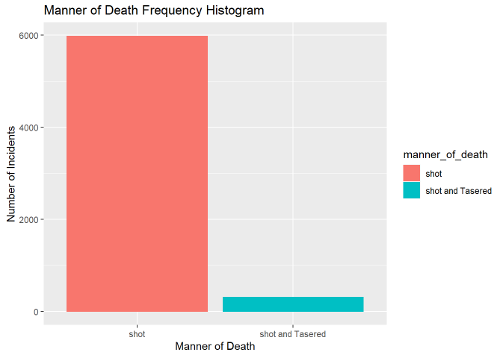
Univariate Analysis #2: Manner of Death

Slide 5
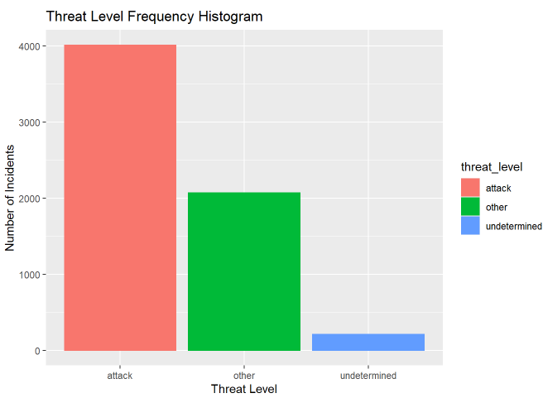
Univariate Analysis #3: Threat Level

Slide 6
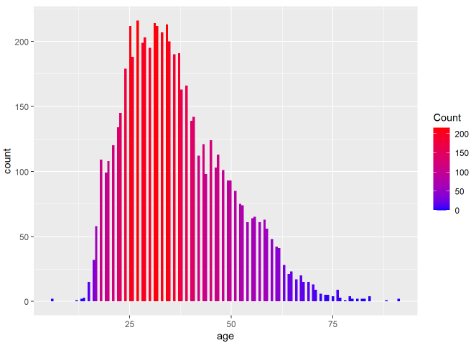
Univariate Analysis #4: Age

Slide 7
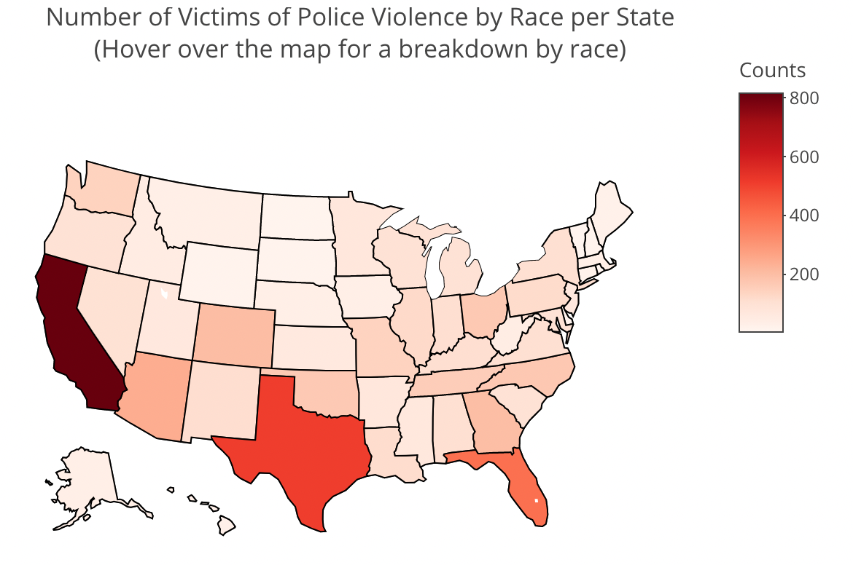
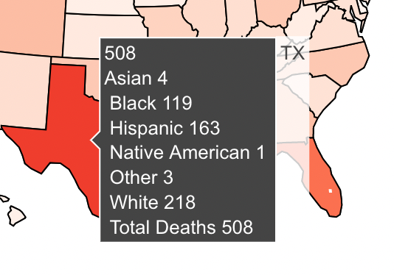
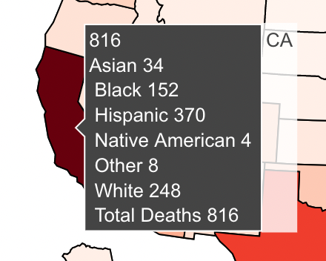
Multivariate Analysis #1: Race and State

Slide 8
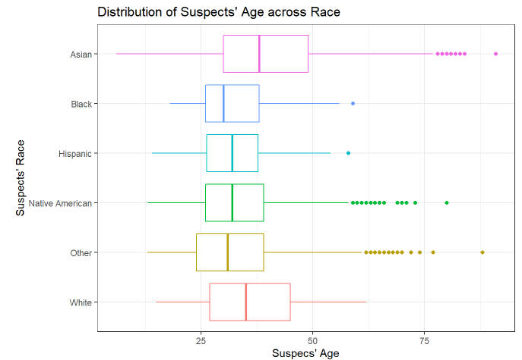
Multivariate Analysis #2: Age and Race
We see from the boxplot below that the median age for Black people that have been killed by police is 29 years.
White people have a relatively higher median age of 35 years whereas Asian people have the highest median age of around 38 years.

Slide 9
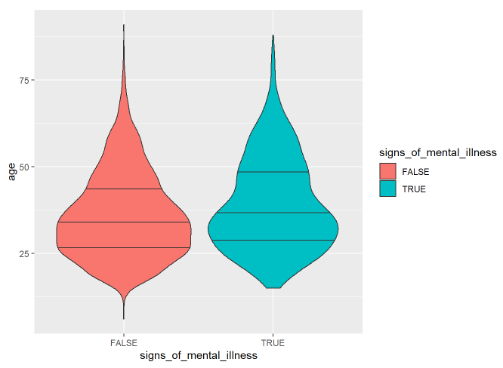
Multivariate Analysis #3: Age and Mental Wellbeing
Signs of mental illness appear more frequently within the 30s age range while death by police for people age 50 and above are more common for people showing signs of mental illness.

Slide 10
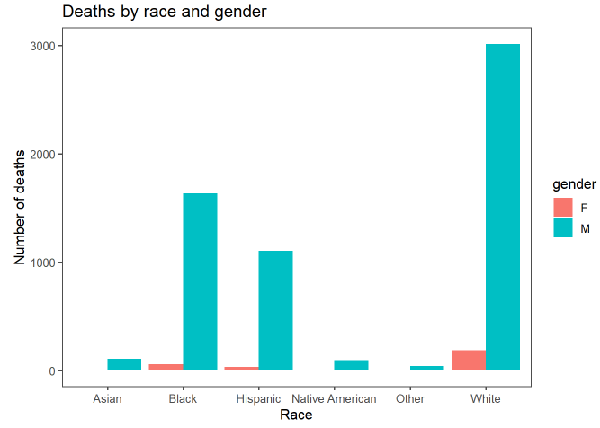
Multivariate Analysis #4: Race and Gender
Individuals across all races that were shot and killed by police were more often men.

Slide 11
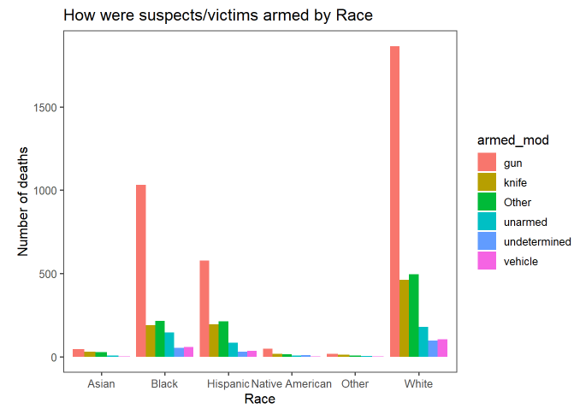
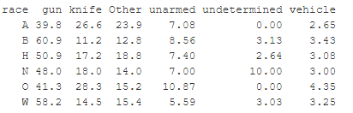
Multivariate Analysis #5: Race and Armed Status
We discovered that around 9% of the Black victims were unarmed whereas only approximately 6% of the White victims were unarmed. Guns were the most used weapon across all races except for Asian individuals. Asian victims were more often wielding knives.

Slide 12
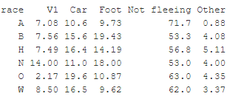
Multivariate Analysis #6: Race and Flee Status
Only 53% of Black victims shot were not fleeing whereas 71% of the Asian victims who were shot were not trying to flee.
The car is the most popular method of fleeing among White victims whereas for Black victims, the most popular method of fleeing was by foot.

Slide 13
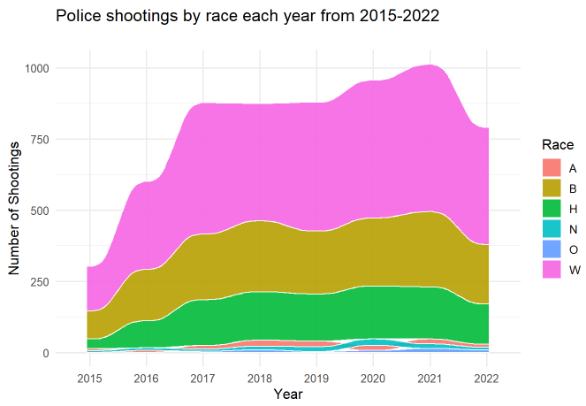
Multivariate Analysis #7: Race and Year

Slide 14
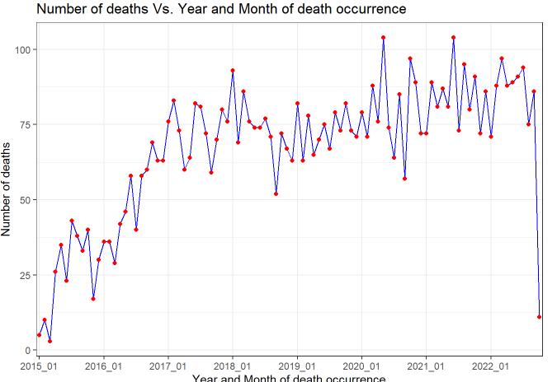
Time Series Analysis

Slide 15
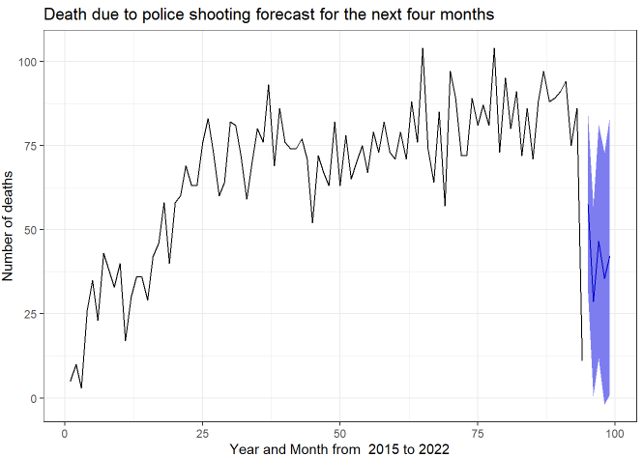
Time Series Analysis: Seasonality
Surprisingly, there is seasonality across year or months in police shootings. We looked into the monthly trend over 8 years and used ARIMA to forecast the likely number of police shootings over the next four months. The forecast predicts average shootings for the next four months with a wide confidence interval.

Slide 16
SMART Research Question
Within our data set of 6,574 observations of police shootings from 2015 to 2022 in the United States, is there a significant difference between the U.S. States’ proportions of fatal police shootings that are captured by body cameras?
S
Variables that matter for our question: US state where the shooting took place and whether the police body camera was on or off
M
Statistical analysis used to measure differences between many proportions (this will require data reshaping)
A
The amount of data is manageable with only 6,574 observations spanning over a seven-year period.
R
We may apply this research to state policy on body cameras during police work.
T
With three people working on this research, a couple of weeks are required to perform the data analysis.

Slide 17
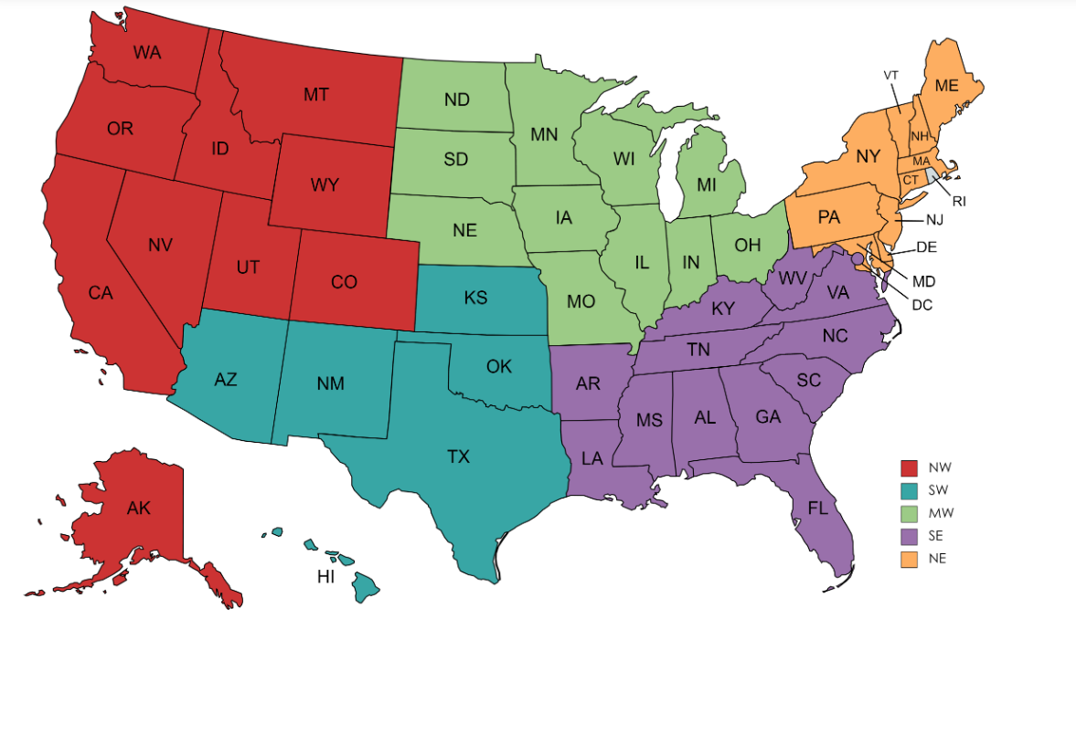
Reshaping Our Data for the SMART Q
Group data and variables by state to foster comparisons at the state level
Separated the data into regions for graphical display purposes

Slide 18
A Key New Variable: stbcp
stbcp = the proportion of an officer’s body camera being on during a fatal shooting
Mean of stbcp= 0.144
This will allow us to compare states by proportion…

Slide 19
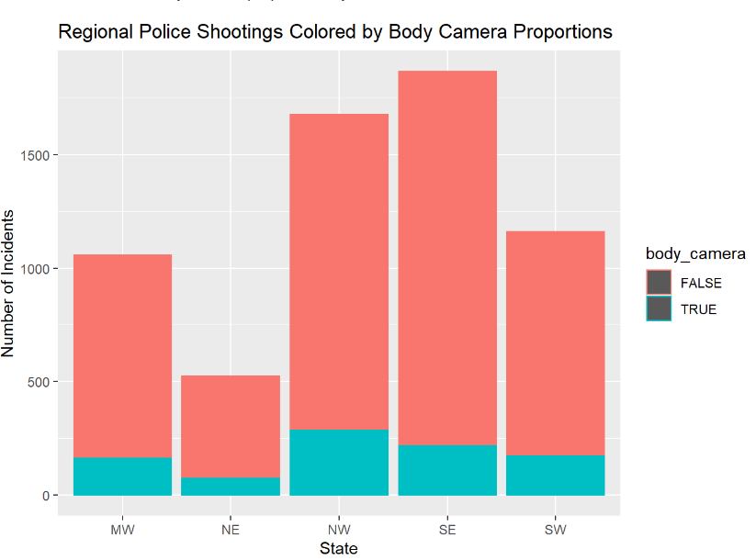
Body camera status by region

Slide 20
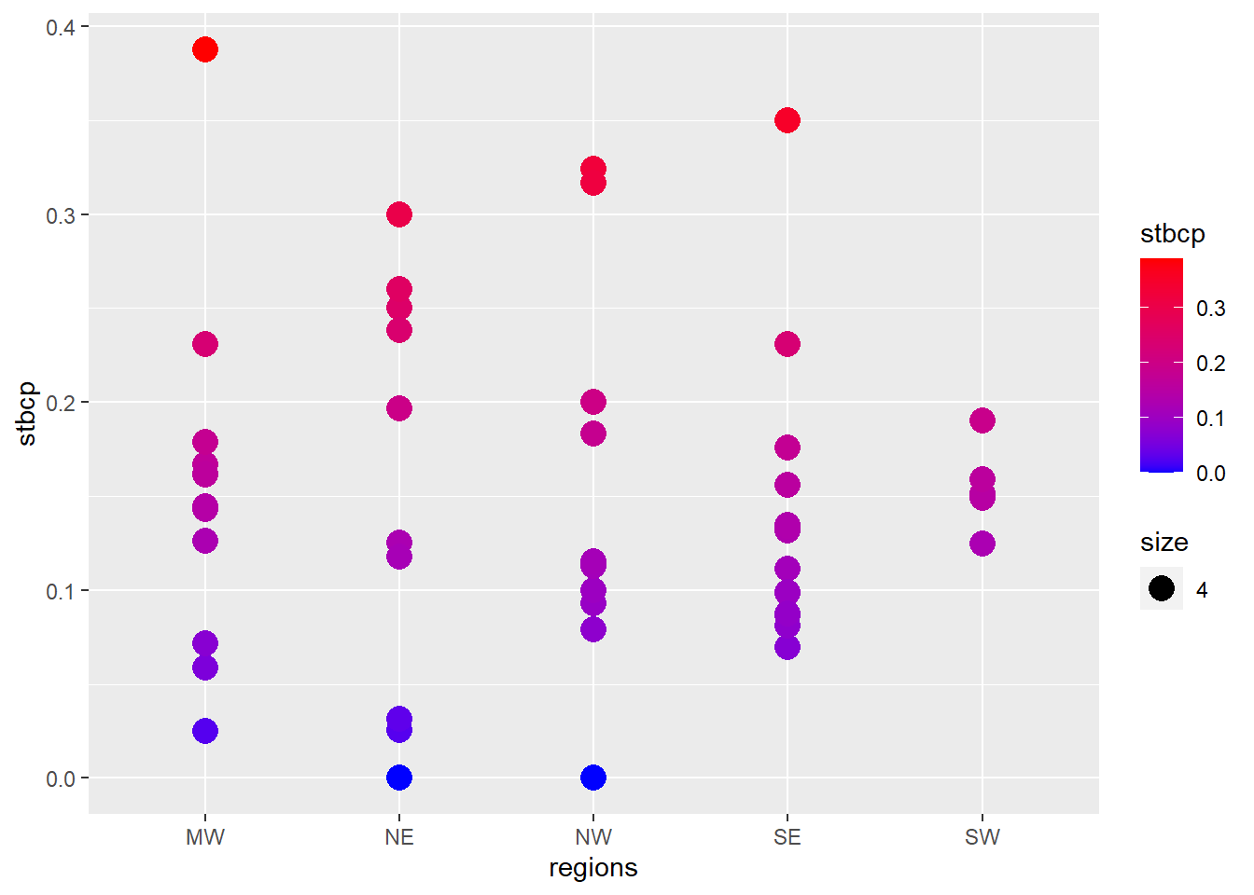
The variable stbcp by region

Slide 21

How do we measure a significant difference?
Introducing: The Chi-Square Test
The Chi-Square Test (X^2) is a test for comparing distributions of categorical variables
It works by comparing counts of each category and seeing if they differ from a preconceived “expected amount”
The Null Hypothesis is always: “The proportions are all equal” and The Alternative Hypothesis is always “The proportions are not all equal”
This test outputs a p-value (just like Z and T tests)

Slide 22
What are the conditions for using a Chi-Sq Test ?
Both Variables are Categorical
We can check this off because “state” and “body camera” are
Independent Observations
We know our observations to be independent as none of them meaningfully increase the probability of others (within the scope of this project)
Mutually Exclusive Categories
Satisfied
Expected value of cells should be 5 or greater in at least 80% of cells
Let’s talk about that…
Source: https://www.statology.org/chi-square-test-assumptions/

Slide 23
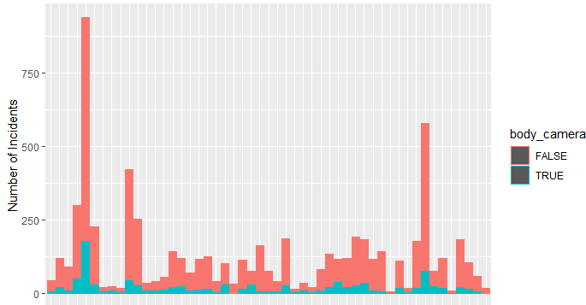
Conditions for using a Chi-Sq Test
We can see in our previous graphs that all our states have at least n=33 observations and the mean of stbcp is 0.144.
So, for the smallest number of state observations (AK)
0.144*33= 4.752
The rest of the states all have larger observation numbers (next smallest is 39), so we can say that 80% of our data easily passes this threshold of 5.
Source: https://www.statology.org/chi-square-test-assumptions/

Slide 24
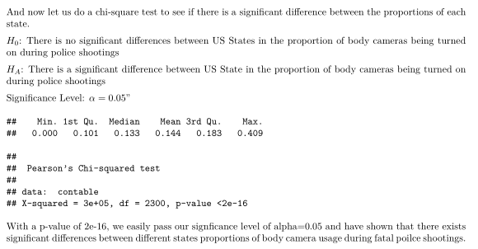
The results
Source: https://www.statology.org/chi-square-test-assumptions/

Slide 25
Questions?

